Slide 1
第十一章 星系
§11.1 银河系
一、银河系的结构 ：银盘、银晕、银核、旋臂
二、银河系的自转 ：刚体转动、开普勒转动、较差转动
三、银河系的质量和光度 ：总质量＞10¹¹太阳质量；累计光度约为太阳光度的2.4×10¹⁰倍
四、银河系核心的活动：估计有大量暗物质
五、银河系旋臂的旋开与旋闭 ：银河系成旋涡星系 ，旋臂开或闭目前还有争议。
六、星系的结构 ：有椭圆、有旋涡和不规则

Slide 2
§11.2 河外星系
银河系以外的星系统称为河外星系。
沙普利－柯蒂斯大争论
一、河外星系的分类
1.哈勃形态分类：椭圆星系、旋涡星系、棒旋星系、透镜星系和不规则星系五大类。
2. 依活动与否分类：正常星系（包括椭圆星系、旋涡星系等）和活动星系 （见图）
3.类星体和活动星系核
二、星系的光度和光谱

Slide 3
四、河外星系的自转和空间运动
五、河外射电源和射电星系
六、活动星系
七、星系核的活动
（见 图）
§11.3 星云
指真正云雾状天体，是银河系内太阳系以外一切非恒星状的气体尘埃。由于历史的缘故，一些天体本是星系，但在名称上仍叫星云。
一、星云的密度：介于星际物质与原始恒星之间。
二、星云的质量：有大有小
三、星云的成分：以氢和氮为主
四、星云的种类（见图）
（1）按形状分：弥漫星云和行星状星云
（2）按发光的性质分：发射星云、反射星云、暗星云
Notes:
A spiral galaxy Ascompressional waves pass through the molecular clouds, they trigger vigorous star birth. This process produces numerous H II regions and clusters of 0 and B stars that outline the spiral arms. Each pinkish speck along the spiral arms of this galaxy is an H II region. (Anglo-Australian Observatory)

Slide 4
§11.4星系团和总星系
天体系统有级别和大小，如：
地月系、太阳系、银河系、河外星系、双重星系……
一、双重星系和多重星系
二、星系群和星系团
三、总星系－－目前我们认识的宇宙
（见图）
§11.5星系的起源和演化
一、银河系的起源和演化（见图）
二、河外星系的起源和演化

Slide 5
复习与思考题
银河和银河系有何区别？
太阳在银河系中的位置是如何确定的？
银河系的结构如何？它是怎样旋转的？
银河系的核心是如何活动的？旋臂是怎样运动的？
河外星系如何分类？
河外星系是如何运动的？
何谓总星系？它与宇宙有何区别和联系？
银河系是怎样起源和演化的？
河外星系是怎样起源和演化的？
什么叫引力不稳定假说？什么叫宇宙湍流假说？
进一步讨论题
从光学的宇宙到全波段看到的宇宙所获得的信息，阐述人类对星系的认识过程。

Slide 6
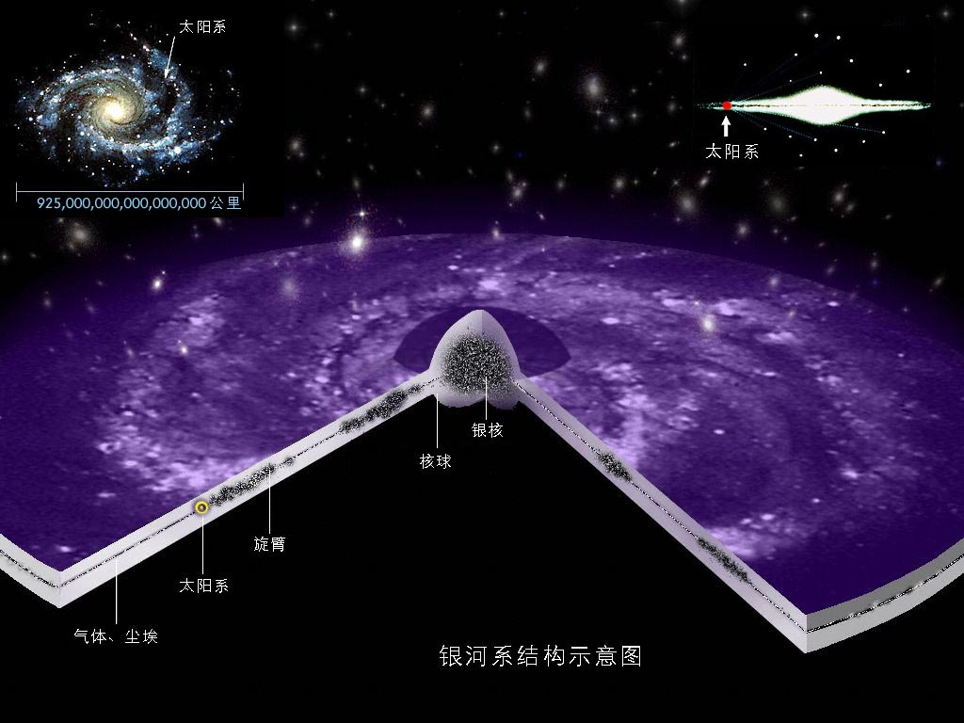
Notes:
A globular cluster is a spherical cluster that typically contains a few hundred thousand stars. This particular cluster, call M13, is located in the constellation of Hercules roughly 25,000 light years from Earth. (U.S. Naval Observatory).

Slide 7
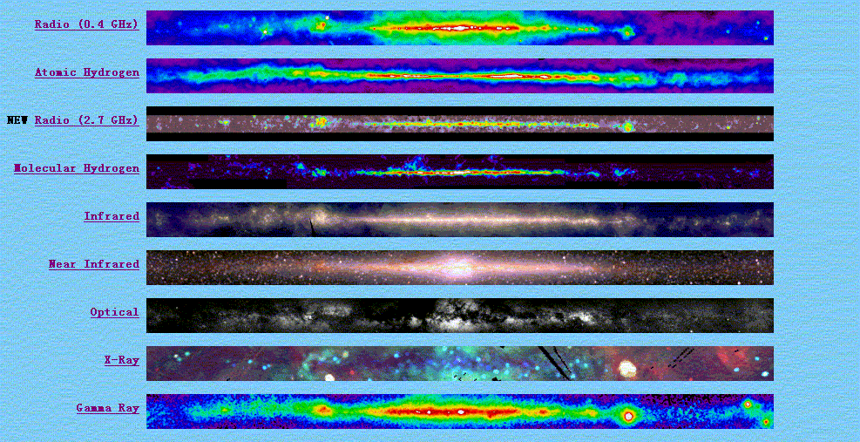
The galaxy NGC 253
不同波段获取的银河系信息
Notes:
A spiral galaxy, such as our own or NGC 253, contains a significant amount of interstellar dust, primarily concentrated in the galaxy's disk. In our own galaxy, this dust blocks light from remote stars and severely restricts our visual observations in the plane of the Milky Way. In other galaxies,
the dust appears as dark blotches and mottling, as shown here. The pinkish spots scattered around this galaxy are H II regions that outline the spiral arms. NGC 253 belongs to a cluster of galaxies called the Sculptor group, nearly 10 million light years from Earth. (Anglo-Australian Observatory)

Slide 8
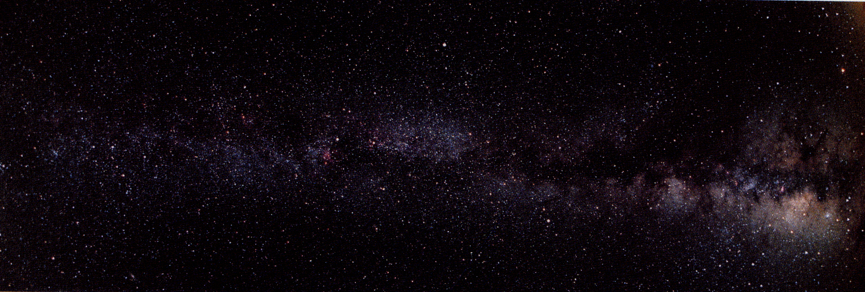
银河 （银河系的投影）

Slide 9
沙普利－柯蒂斯关于银河系和河外星系的大争论
1920年，在美国国家科学院，柯蒂斯与沙普利的两种不同观点正式交锋，虽然在这场论战中柯蒂斯占了上风，却并未有得出公认一致的结论，直到三年后，哈勃给出的观测事实，才使上述论战有了决定性的结果。1923年，威尔逊山天文台建成了2.5米口径的天文望远镜，哈勃利用它在仙女座星云外缘找到一颗造父变星，根据其光变周期与光度之间的关系，他推断出该星的距离为15万秒差距（实际为80万秒差距），比沙普利的银河系要大得多。这表明，仙女座大星云是一个河外星系，从而结束了河外天体是否存在的辩论，使天文学家的研究领域迈出了银河系。

Slide 10
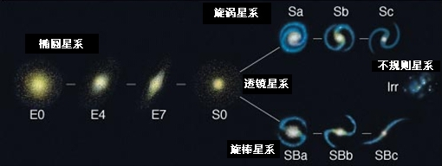
哈勃星系分类

Slide 11
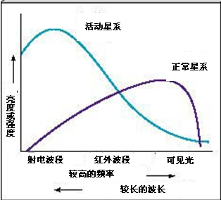
正常星系和活动星系比较

Slide 12
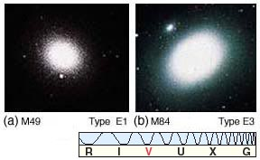
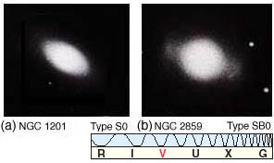
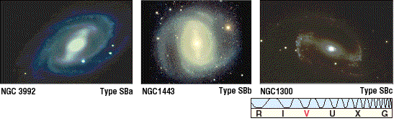
Notes:
As with spiral galaxies, Hubble classified barred spirals according to the winding of their spiral arms and the size of the central bulge. Three examples are shown here. (Mount Wilson and Las Campanas Observatories)

Slide 13
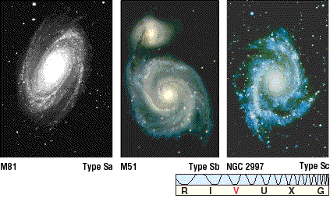
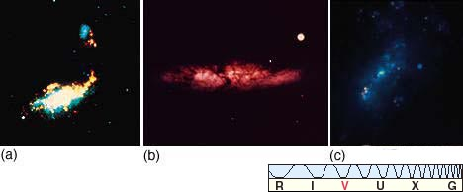
Notes:
Hubble classified spiral galaxies according to the winding of the spiral arms and the sue of the central bulge. Three examples are shown here. (Mount Wilson and Las Campanas Observatories)

Slide 14
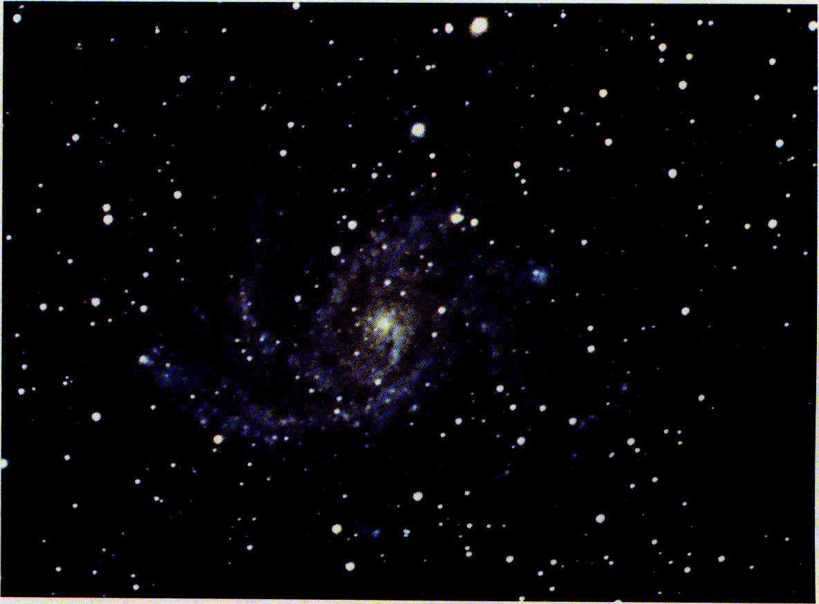
旋涡星系NGC6946
Notes:
If we could view our galaxy face-on from a great distance, it would look somewhat like this spiral galaxy in the constellation of Cygnus. The spiral arms are outlined by numerous H II regions and OB associations. (U.S. Naval Observatory)

Slide 15
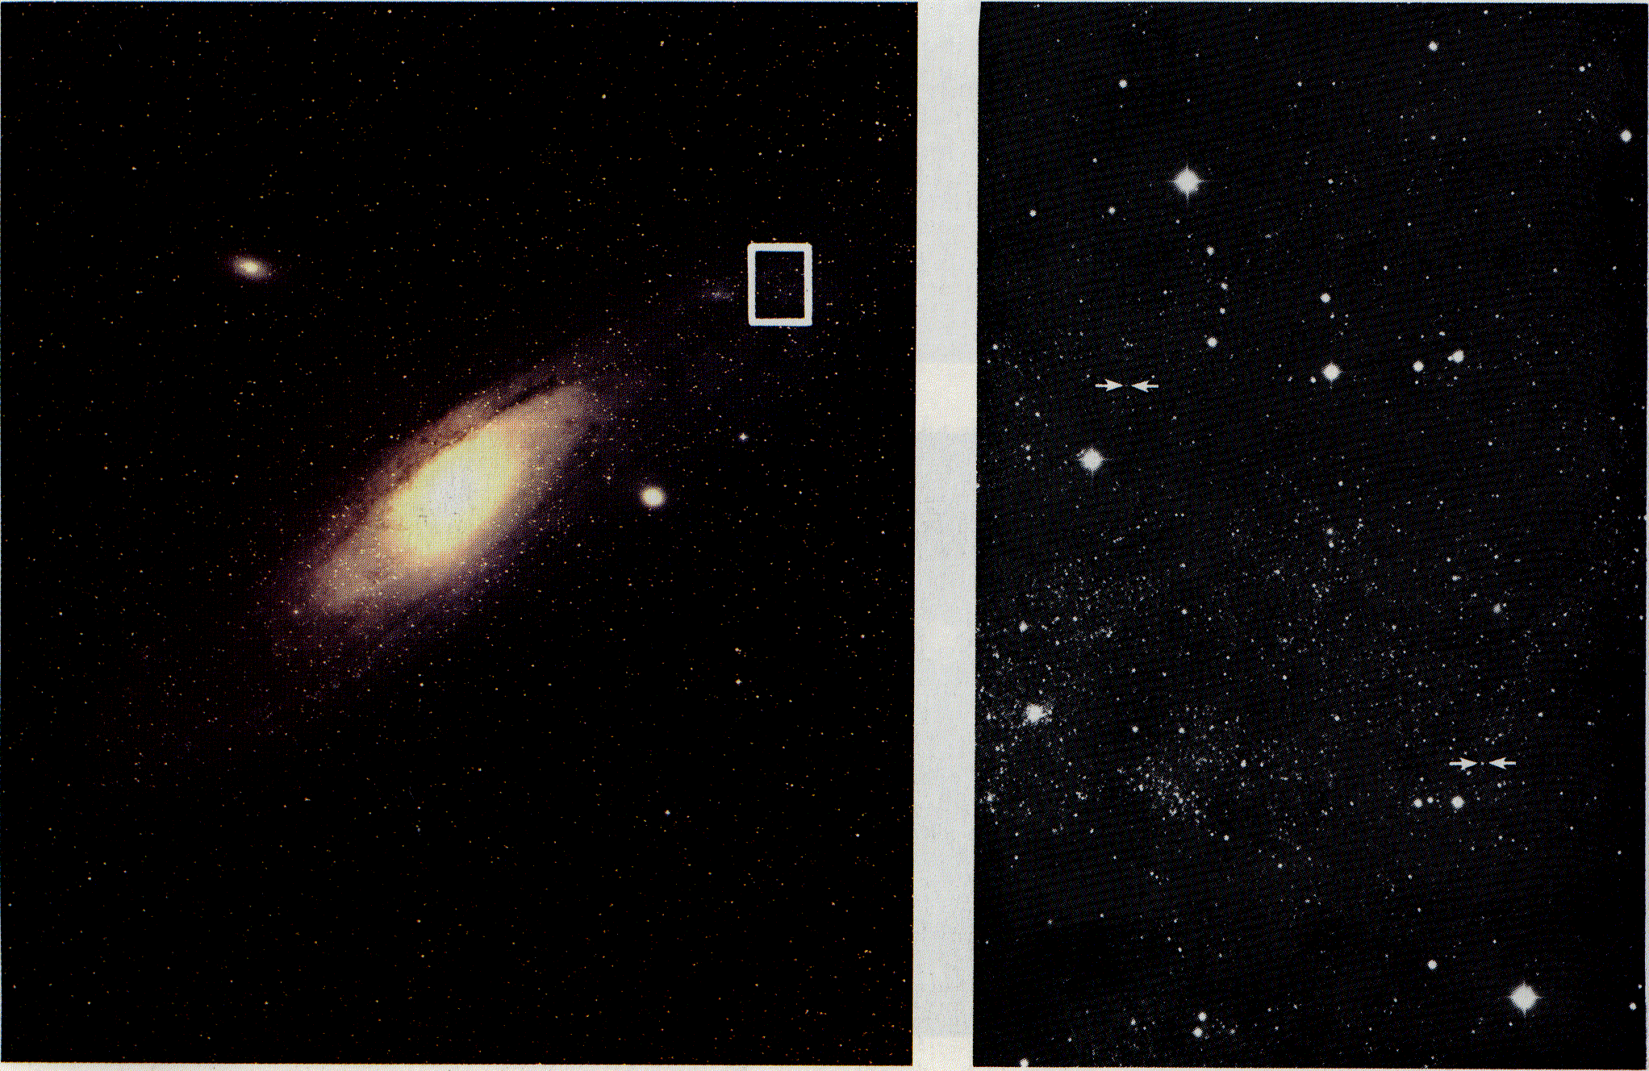
[left] The Andromeda Galaxy （仙女座星系 。也叫：M31 或 NGC 224)）
[right] Cepheid variables in the Andromeda Galaxy
Notes:
[left] The Andromeda Galaxy (called M31 or NGC 224) This nearby galaxy covers an area of the sky roughly five times as large as the full moon. Under good observing conditions, the galaxy's bright central bulge can be glimpsed in the constellation of Andromeda with the naked eye. The distance to the galaxy is 2¼ million light years. The white rectangle outlines the area shown in Figure 17-4. (Palomar Observatory)
[right] Cepheid variables in the Andromeda Galaxy Two Cepheid variables are identified in this view of the outskirts of the Andromeda Galaxy. Because these stars appear so faint (although they are in fact very luminous), Hubble successfully demonstrated that the "Andromeda nebula" is extremely far away. (Mount Wilson and Las Campanas Observatories)

Slide 16
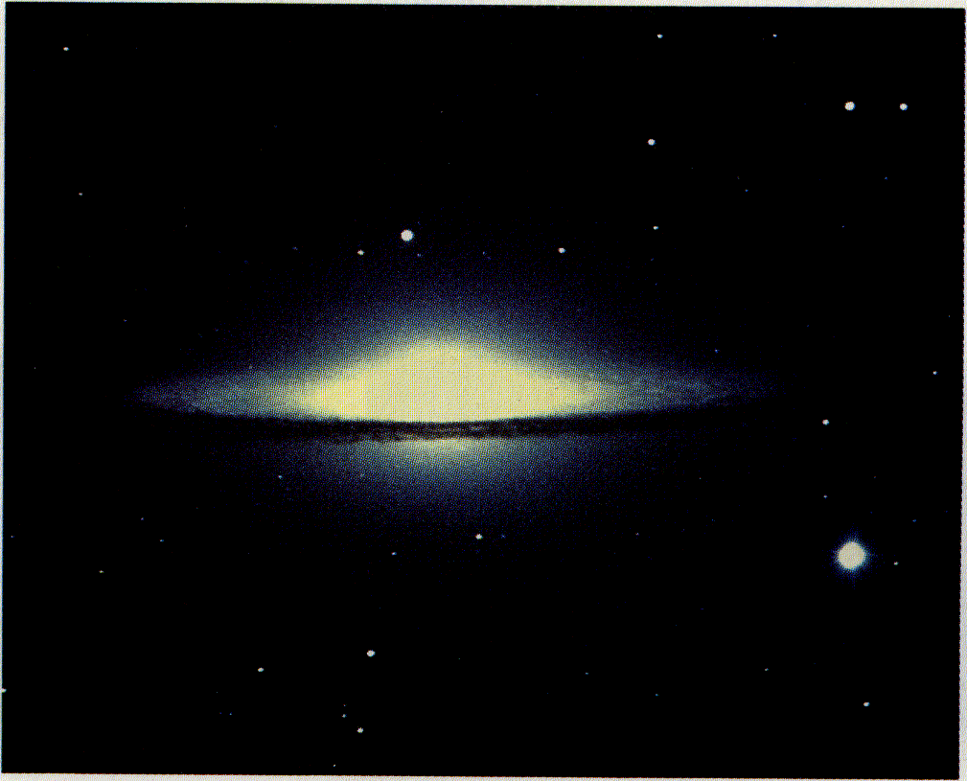
草帽星系。也叫 M104 或 NGC 4594属于不规则星系
Notes:
Because of the large size of its central bulge, this galaxy is classified as an Sa. If we could see it face-on, we would find that the spiral arms are tightly wound around a voluminous bulge. This galaxy is in the constellation of Virgo and is tilted by only 6° from our line of sight. (NOAO)

Slide 17
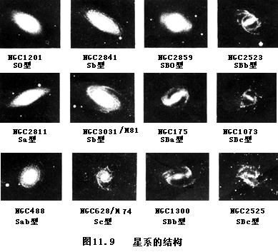

Slide 18
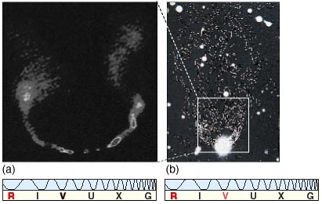
NGC265

Slide 19
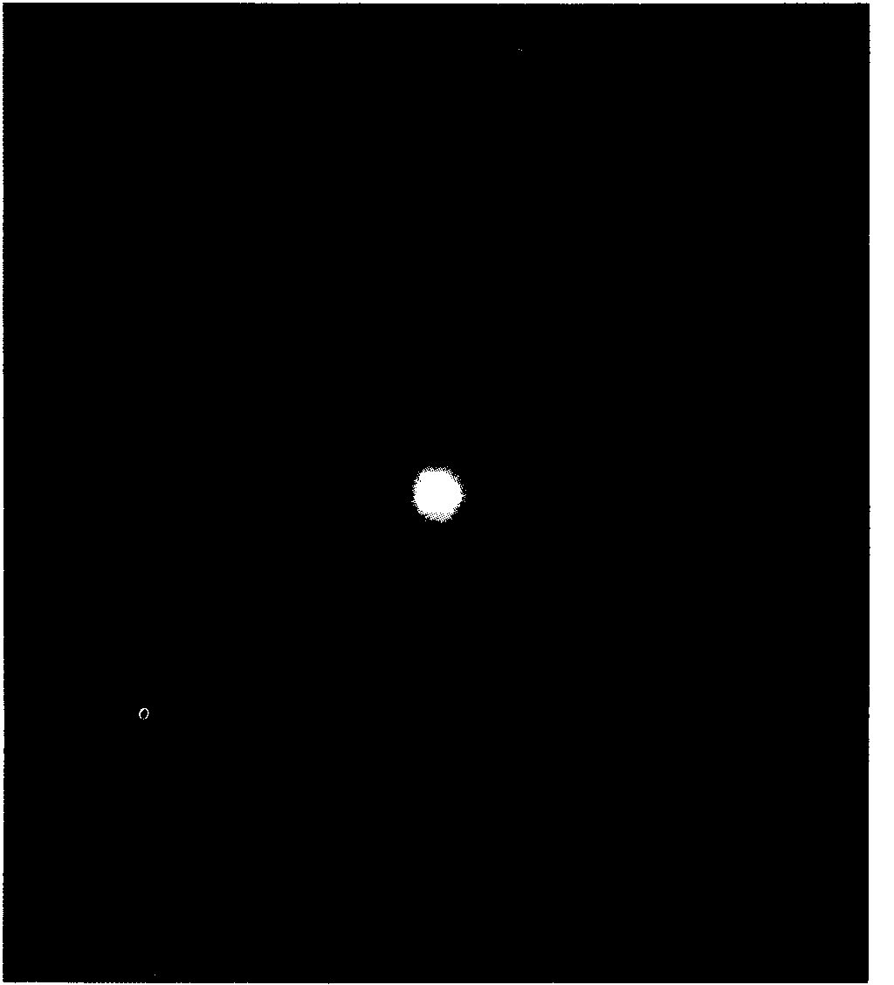
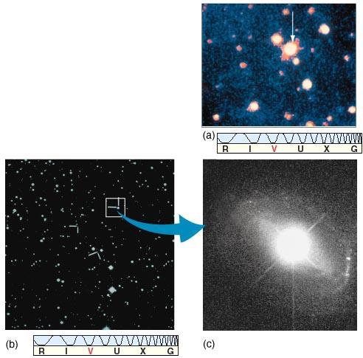
The quasar 3C 48 （类星体3C48）
类星体的发现

Slide 20
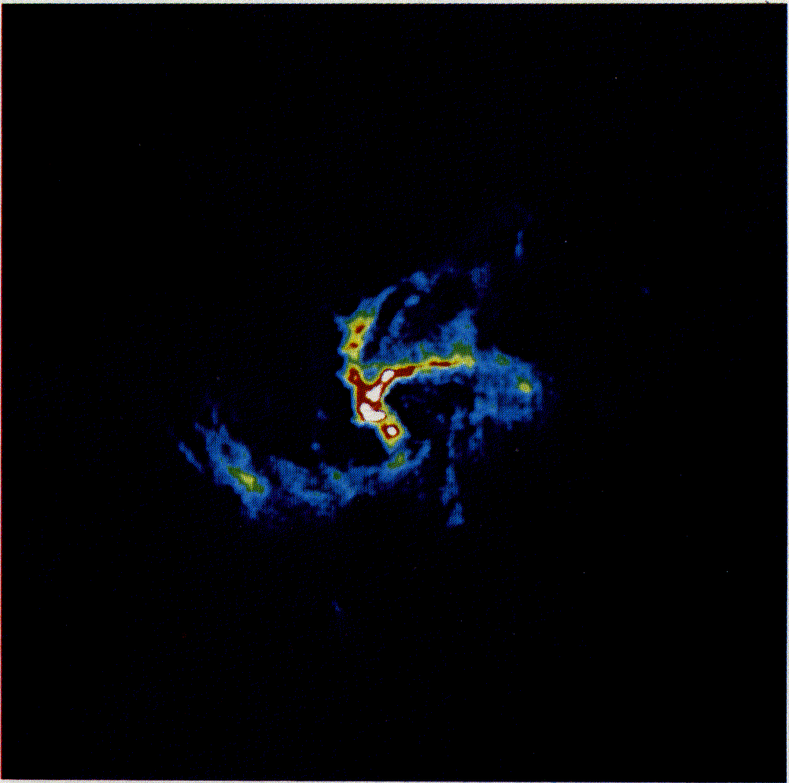
The galactic nucleus （星系核）
Notes:
This color-coded radio map shows the appearance of the center of our galaxy at a wavelength of 6 cm. The strongest radio emission is shown in red. Weaker emissions are colored green through Hue. The bright red object at the middle of this view is a compact radio source precisely at the center of our galaxy. The area covered in this view measures about 10 light years across. (Courtesy of K. Y. Lo and M. J. Claussen)

Slide 21
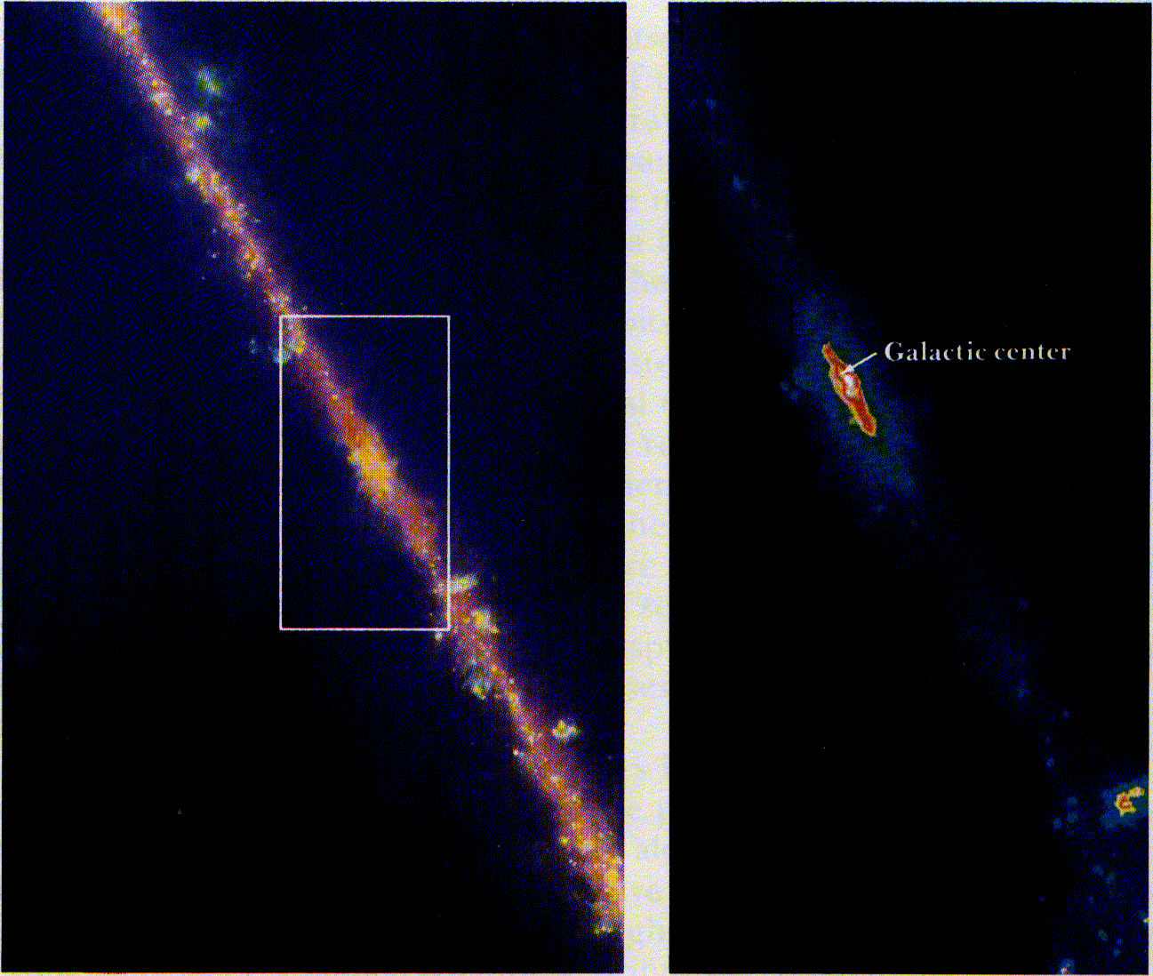
[left] The galactic center at infrared wavelengths (红外波段星系中心）
[right] The galactic nucleus at infrared wavelengths （红外波段星系核）
Notes:
[left] The galactic center at infrared wavelengths This "false-color" infrared view from IRAS covers a field about 48 X 33. Black represents the dimmest regions of infrared emission, with blue the next dimmest, followed by yellow and red, with white for the strongest emission. The numerous knots and blobs along the plane of the galaxy are interstellar clouds of gas and dust heated by nearby stars. (NASA)
Figure 16-16(c) [right] The galactic nucleus at infrared wavelengths Streamers of dust around the galactic center are visible in blue in this "false-color" view from IRAS that covers the region indicated by the white rectangle in Figure 16-16b. The bright object near the lower right is a large H II region (NGC 6337) about 7 southwest of the galactic center. The prominent band across this view and the previous IRAS view is a layer of dust in the plane of the galaxy. (NASA)

Slide 22
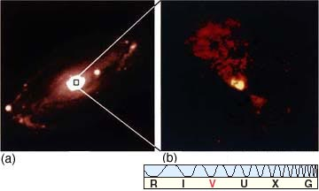
NGC5728, 塞佛特星系
Notes:
Hubble classified elliptical galaxies according to how round or flattened they look. An EO galaxy is round; the flattest elliptical galaxies are E7s. Three examples are shown here. (Yerkes Observatory)

Slide 23
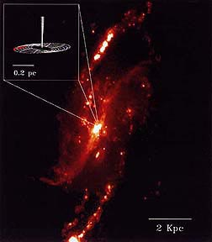
NGC4256

Slide 24
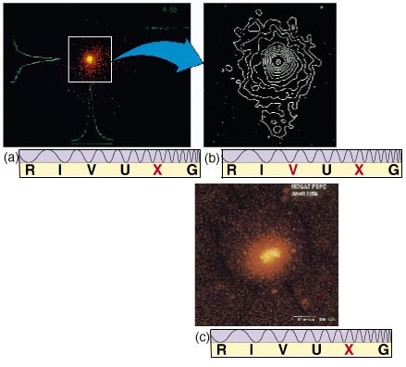
射电星系

Slide 25
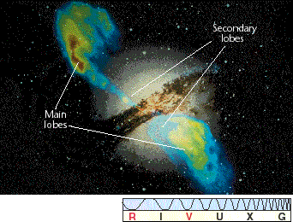
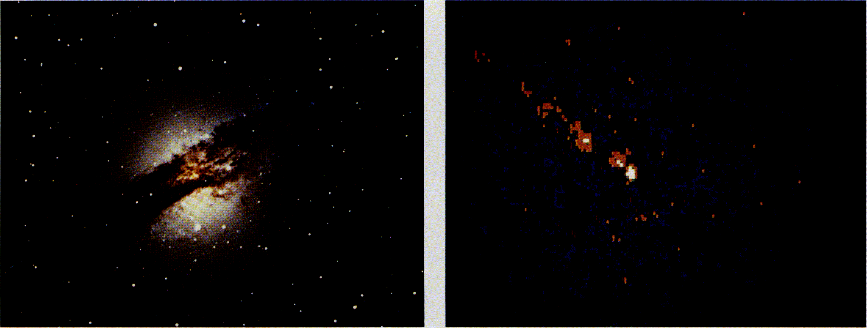
NGC5128，也叫人马座 A星系
射电波段和可见光波段的信息
Notes:
[right] An X-ray image of NGC 5128 This X-ray picture from the Einstein Observatory shows that NGC 5128 has a bright X-ray nucleus. An X-ray jet protrudes from the galaxy's nucleus along a direction perpendicular to the galaxy's dust lane seen in Figure 18-10. Diffuse X-ray emission comes from regions surrounding the galaxy's center. (Harvard—Smithsonian Center for Astrophysics)
[right] An X-ray image of NGC 5128 This X-ray picture from the Einstein Observatory shows that NGC 5128 has a bright X-ray nucleus. An X-ray jet protrudes from the galaxy's nucleus along a direction perpendicular to the galaxy's dust lane seen in Figure 18-10. Diffuse X-ray emission comes from regions surrounding the galaxy's center. (Harvard—Smithsonian Center for Astrophysics)

Slide 26
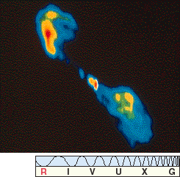
射电星系（耳垂星系）

Slide 27
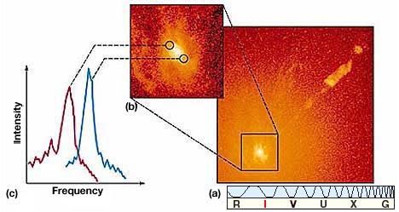
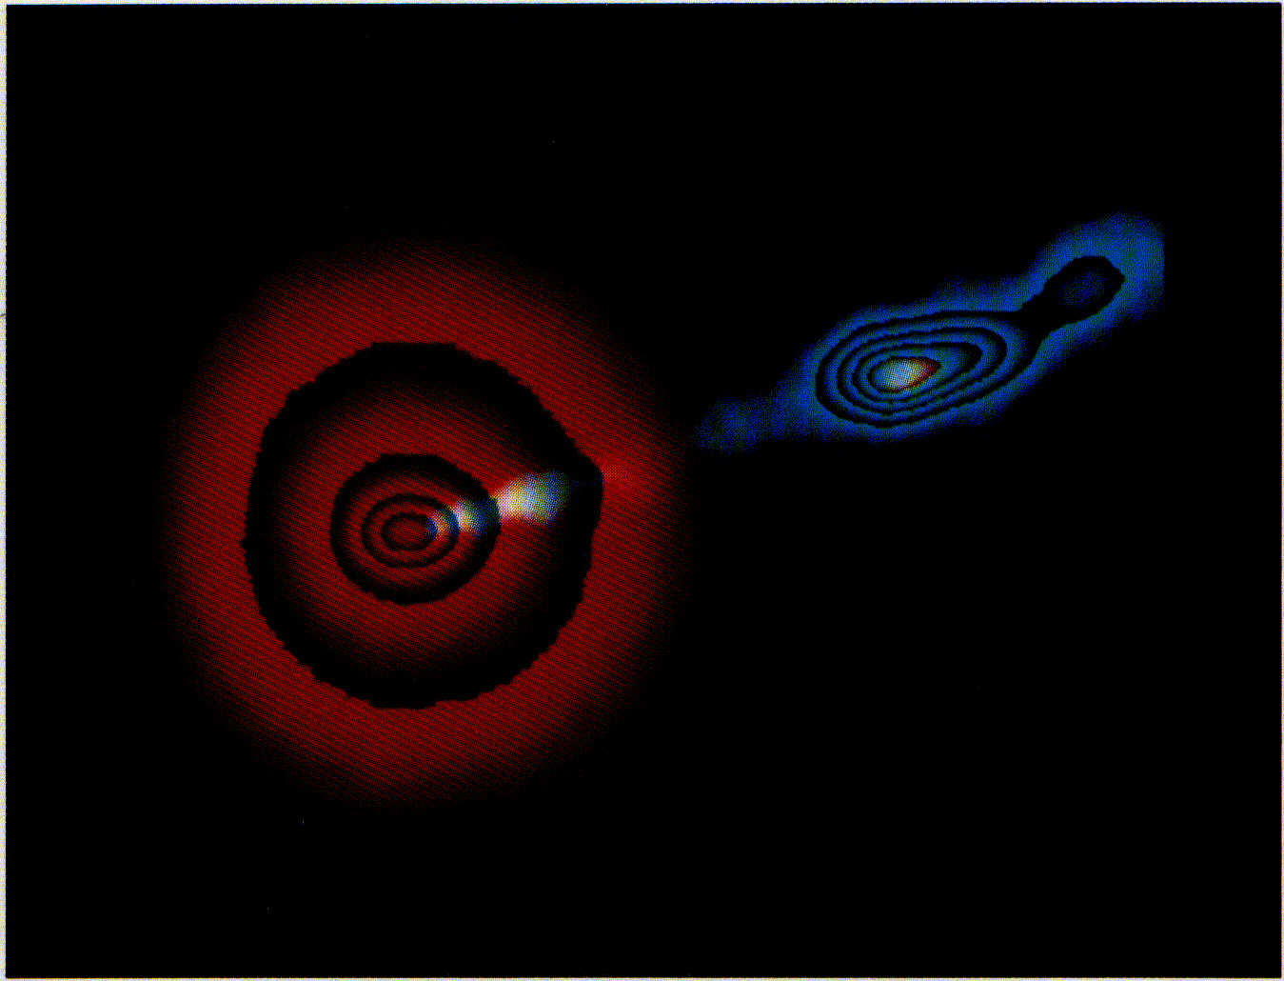
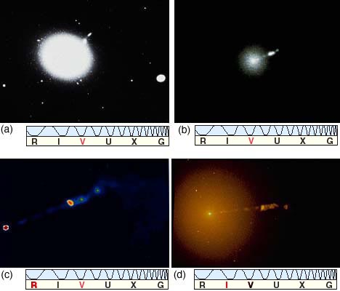
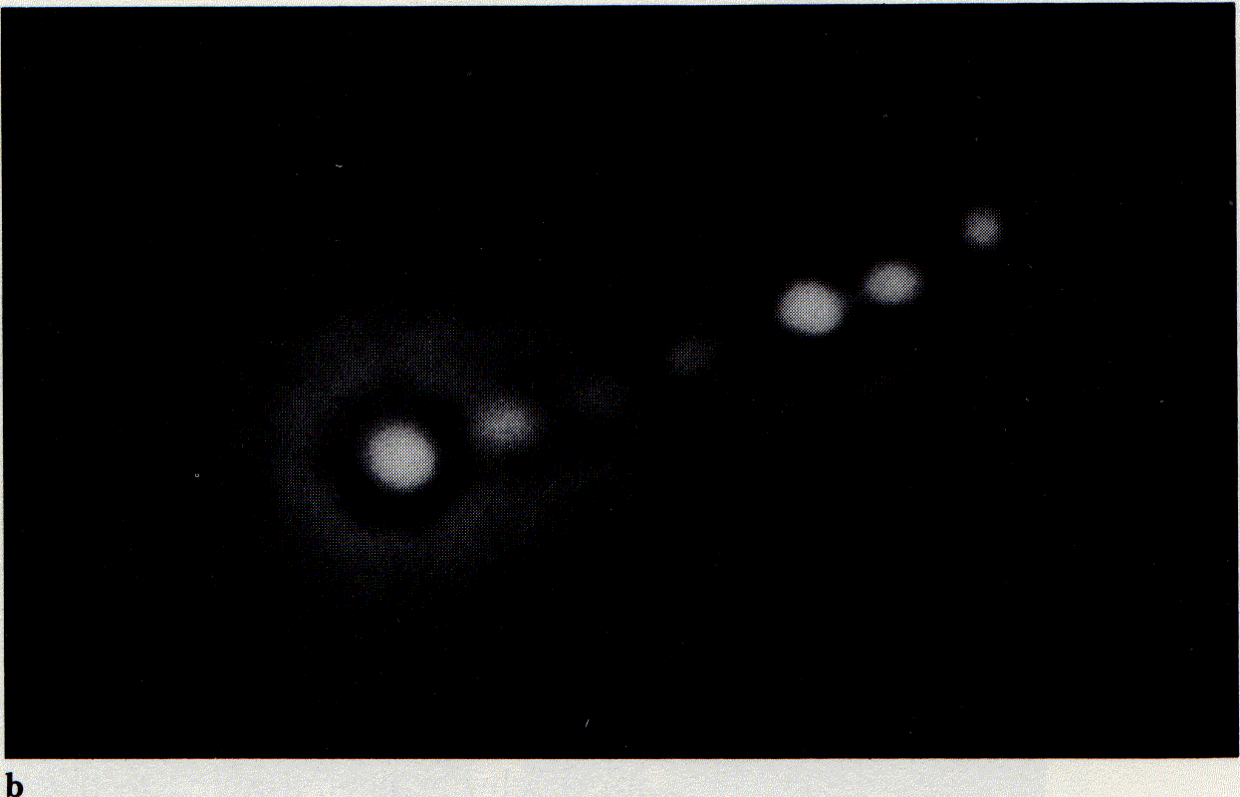
M
87
不同波段获取的信息
M87的核（上）和喷射流（下）

Slide 28
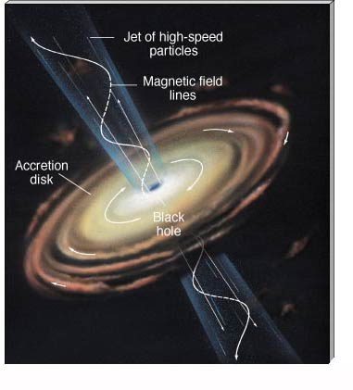
星系核活动

Slide 29
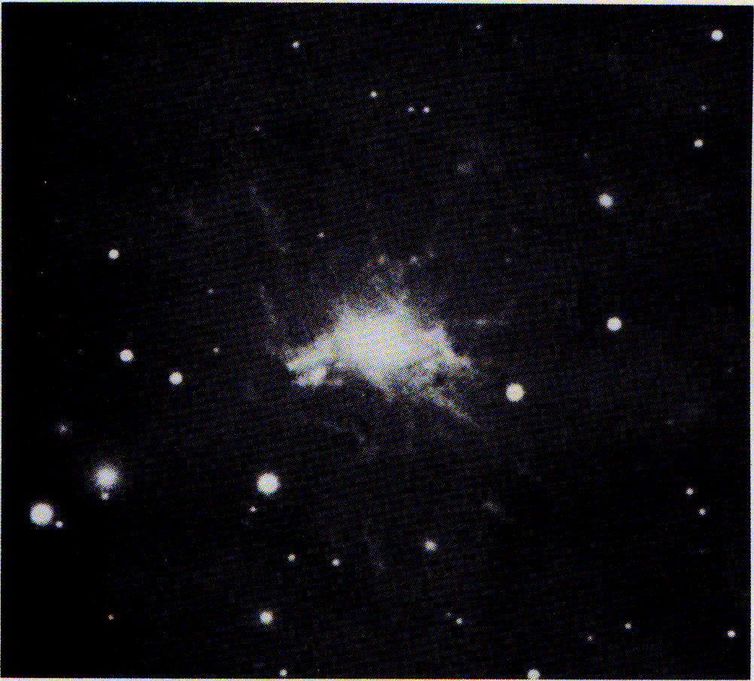
（爆发星系NGC1275，也叫3C84）
Notes:
This Seyfert galaxy, located in the Perseus cluster, is a strong source of X rays and radio radiation. According to the Hubble law, the galaxy's redshift gives a distance of nearly 400 million light years from Earth. Note the streamers of gas. Spectroscopic observations confirm significant mass ejection from the galaxy's center. (NOAO)

Slide 30
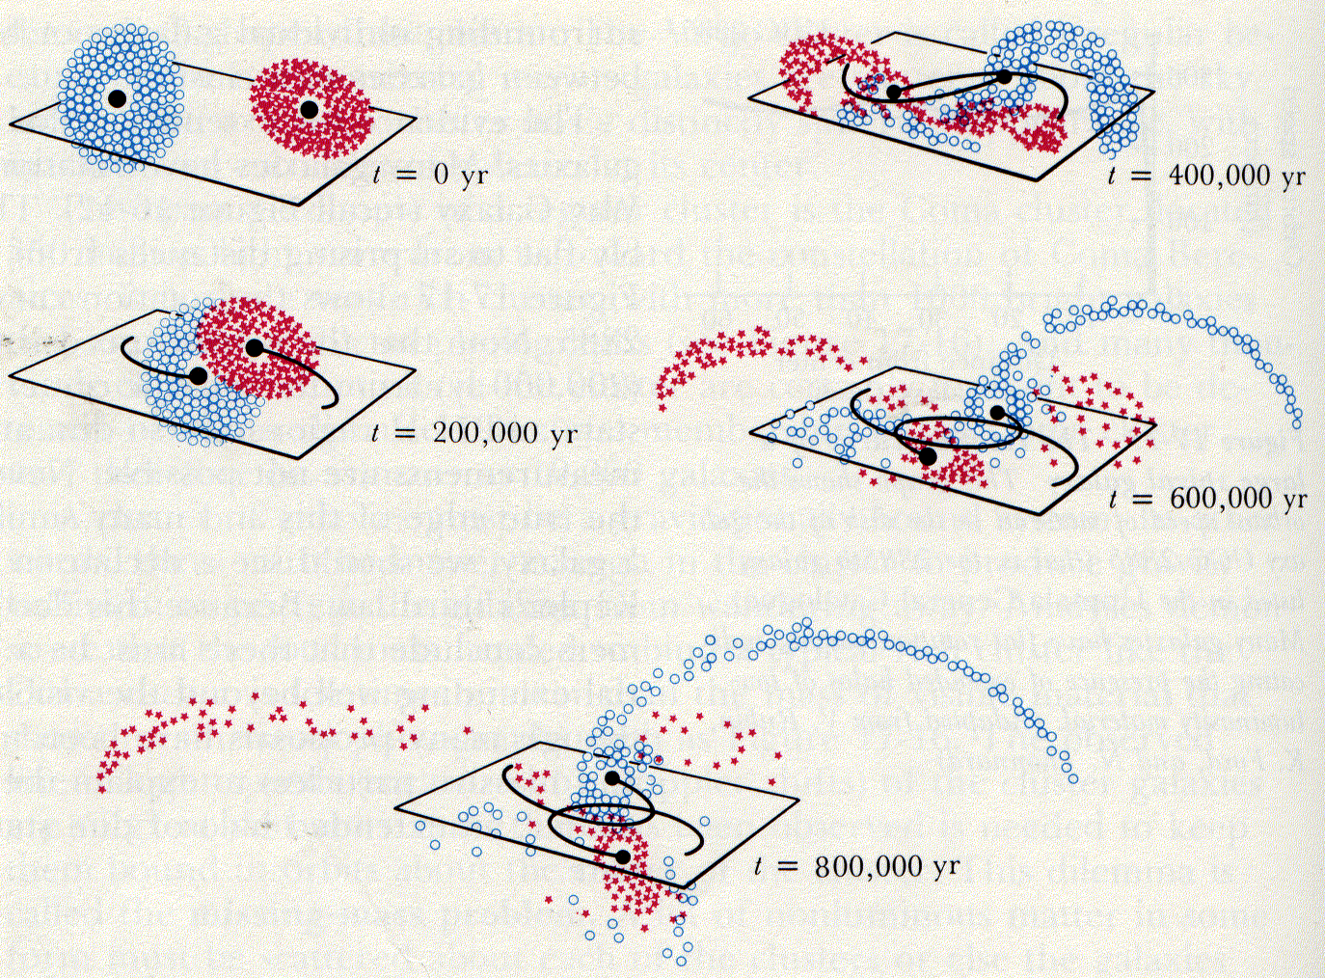
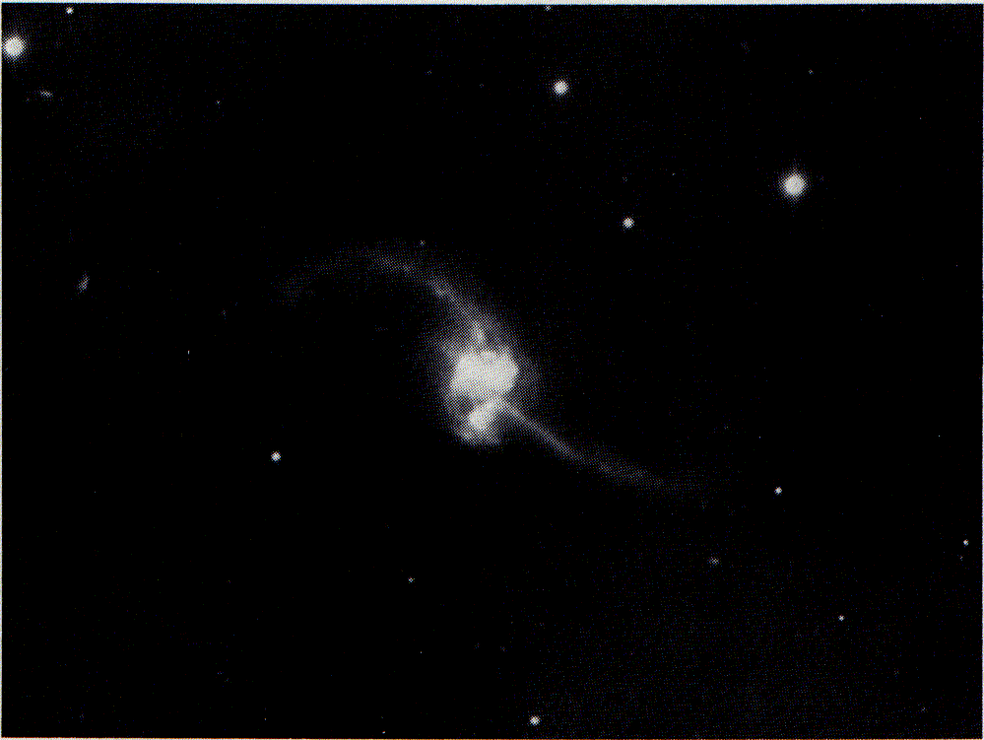
A simulated collision between two galaxies（两星系间碰撞模拟 ）
A colliding pair of galaxies with “antennae” （天线碰撞星系）

Slide 31
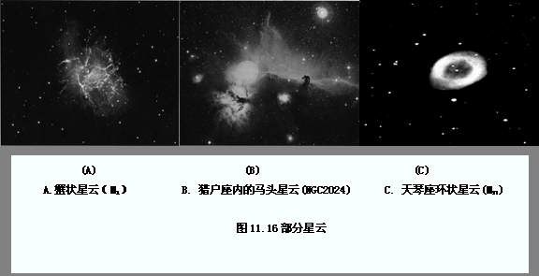

Slide 32
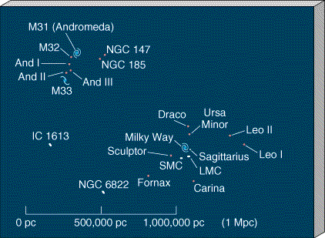
本星系群

Slide 33
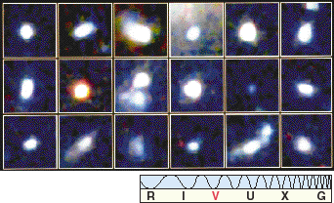
星 团

Slide 34
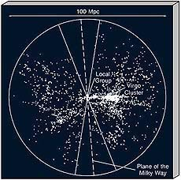
超星系团

Slide 35
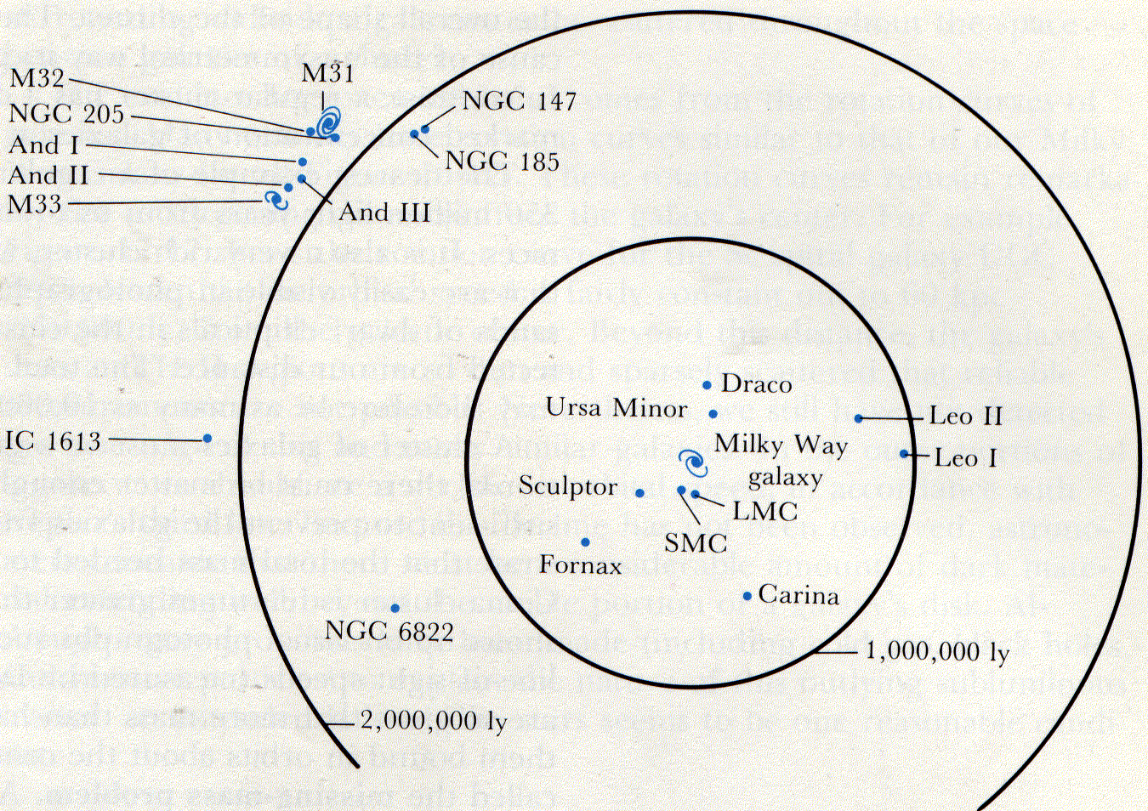
星系团
Notes:
Our galaxy belongs to a poor cluster consisting of about two dozen galaxies, half of which are dwarf ellipticals. Nine galaxies that are less than a million light years from us are satellites of the Milky Way. Similarly, the Andromeda Galaxy has eight satellites.

Slide 36
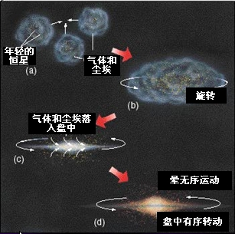
银河系的形成示意图

Slide 37
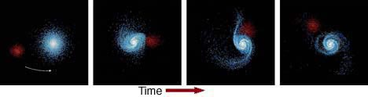
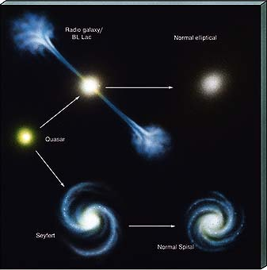
星系的演变

Slide 38
谢谢听讲
第十一章结束

